Slide 1
EP2203r Wall Mount ePoster
Version: 1.0
Date: Sep. 11 2012

Slide 2
Wall-mount ePoster
Model: EP2203r
MP in Dec. 2012
Features:
FHD (1920x1080) panel
Ultra Slim design
LED backlite; power saving
Tempered glass: glassy look-n-feel & reliable for pubic environment usage
Built-in media player for video decoding: full HD video file formats: AVI, WMV, MPG, MPEG, VOB, TS.
Rich I/O: HDMI & VGA to connect to external PC

Slide 3
ID Highlight
Round Design
Thin & Slim
Tempered glass
- Reliable for public usage

Slide 4
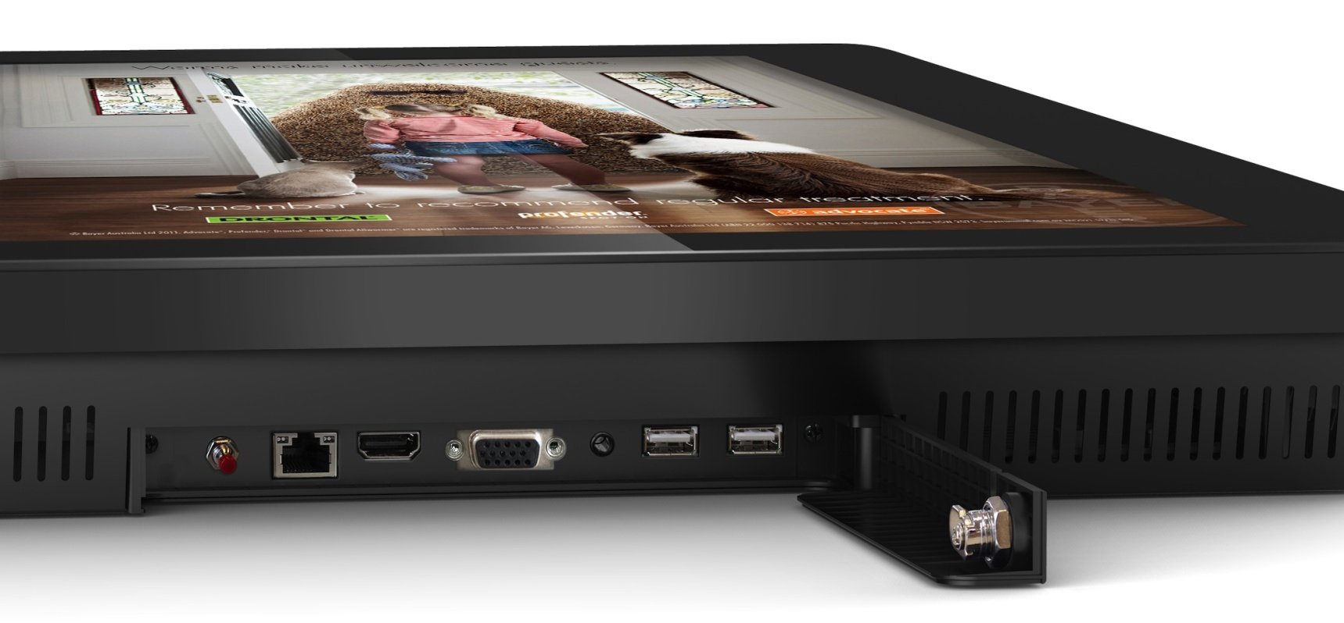
I/O Connectors
Lockable I/O cover

Slide 5
Key Feature
 | EP2203r
Panel size | 22”
Panel resolution | 1920 x 1080
Backlite | LED
Display area (H x V mm) | 478 x 269
Brightness | 250 cd/m2
Contrast ratio | 3000 : 1
Power consumption | 32W
I/O | Video: HDMI/ VGA; USB 2.0 x 2, RJ45 x 1
speaker | 2W, 5Ώ
Dimension (H x V x D mm) | 585 x 378 x 34
Media format
Video | ~ video codec: MPEG1, MPEG2, MPEG4, H.264, AVC, VC-1, RM and WMV ~ video format: mpg, avi, wmv, mkv, flv, mov, mp4, rm, rmvb, ts and tp.
Image | JPEG, GIF, BMP, PNG
Auto power on/off | Set by OSD
CMS for networked operation | ePoster Manager Express plus → not yet mature to promote; will claim as standalone usage first

Slide 6
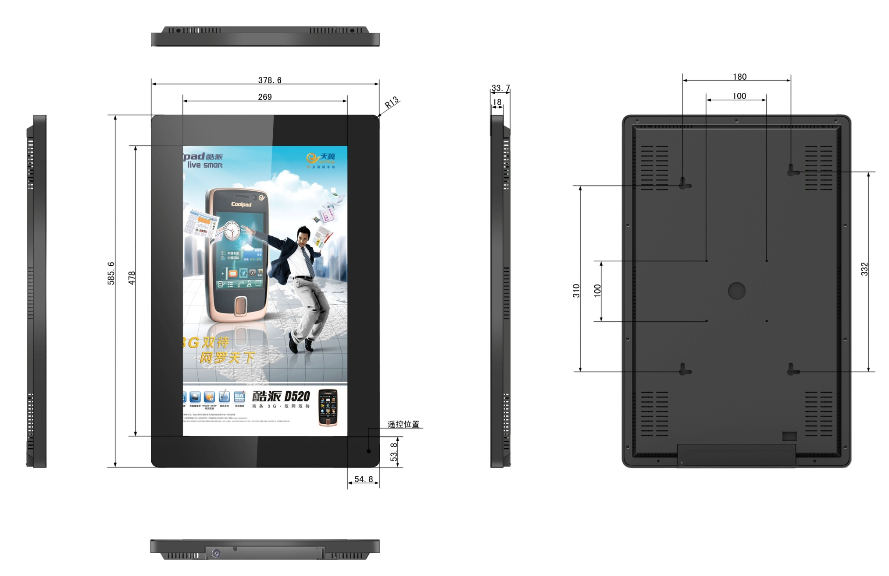
Dimension – EP2203r

